Slide 1

Summary of Findings: Predicting Customer Behaviours
26/1/2024

Slide 2
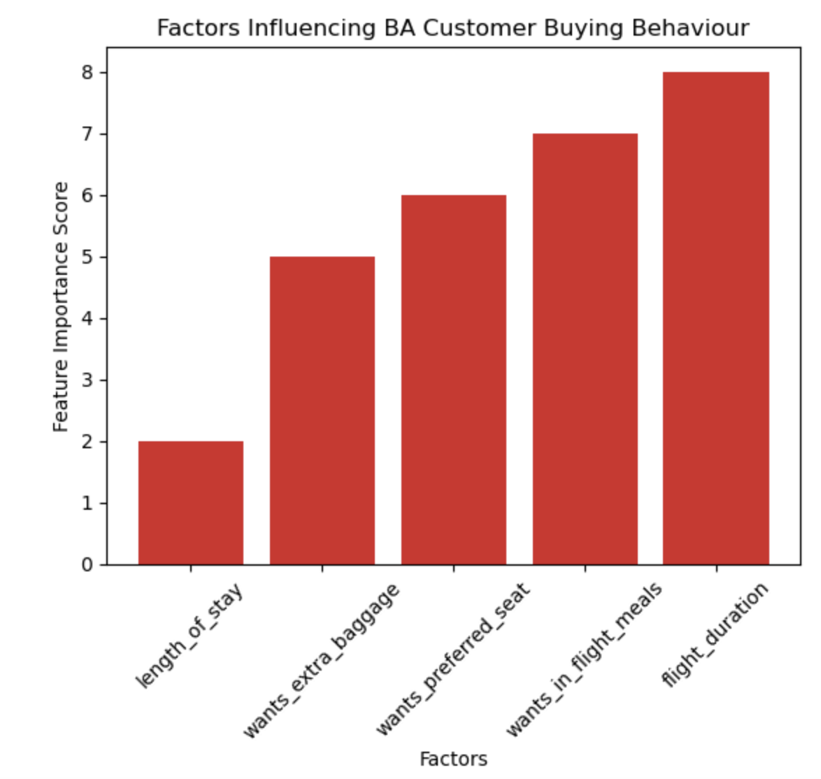
Analysis of the Customer Booking Data included training a Random Forest Regressor Machine Learning model, and then cross validating this 5 times to observe its accuracy.
Analysis shows that the five most influential factors impacting BA customer booking are:
- length of stay
- wanting extra baggage
- the ability to choose seats
- desire for in-flight meals
- flight duration (see right)
The Mean Absolute Error for each of the five models was averaged (mean), to give a MAE of 0.259584116.
-> Although model is fairly accurate, increasing number of data points to supplement test/train data is vital.

